Slide 1
Varignon's Theorem
Dr. Jacob Moore
Associate Professor of Engineering
Penn State Mont Alto

Slide 2
Varignon’s Theorem
Varignon’s Theorem, often called the principle of moments, states that…
“If we have two or more concurrent forces, the sum of the moments that each force creates about a single point will be equal to the moment created by the sum of those forces about the same point.”

Slide 3
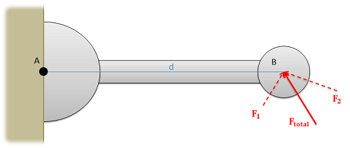
Varignon’s Theorem
In the case below, F₁ + F₂ = F_{total}, and we are taking the moment about point A.
We have two alternate paths to find the overall moment about point A.
Add F₁ and F₂ to find F_{total}, then find the moment F_{total} exerts about point A.
Find the moment from F₁, the moment from F₂, and add those two moments together.

Slide 4
Varignon’s Theorem in Reverse
Varignon’s Theorem is more commonly used in reverse, breaking a single vector into components then finding the moment exerted by each component.
M = M_{x} + M_{y} = (F_{x} * d_{y}) + (F_{y} * d_{x})
M
M_{x}
M_{y}
d_{y}
F_{x}
d_{x}
F
F_{y}

Slide 5
Thanks for Watching
See other engineering mechanics videos and access the full tool at…

Slide 6
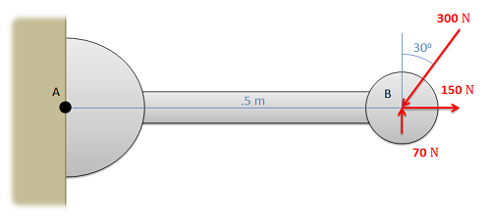
Varignon's Theorem Worked Example
Use Varignon's Theorem to find the moment that the forces in the diagram below exert about point A.

Slide 7
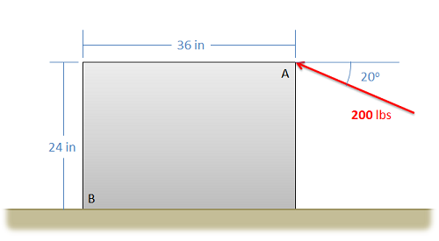
Varignon's Theorem Worked Example
Use Varignon's Theorem to determine the moment that the force at point A exerts about point B.

Slide 8
Varignon's Theorem Worked Example
Use Varignon's Theorem to determine the moment that the force shown below exerts about the base of the post at point O.
6kN
20º
2m
65º
O

